Slide 1

Optimising High-Cost Medicine Utilisation Across NHS Trusts
By Jewel.N data analyst

Slide 2

https://opendata.nhsbsa.net/dataset/finalised-secondary-care-medicines-data-scmd-with-indicative-price
Dataset used - (Finalised) - Secondary
Care Medicines
Data (SCMD) with indicative price - Mar 2025

Slide 3

Business Problem
Secondary care medicines represent a significant portion of NHS expenditure. Variation in prescribing volumes and indicative costs across NHS Trusts may suggest:
Inefficient procurement practices
Variation in clinical pathways
Overuse of high-cost medicines
Opportunities for biosimilar or generic substitution
The task is to identify cost-saving and efficiency opportunities without compromising clinical care.

Slide 4
Business questions pt 1
Which high-cost medicines show the greatest variation in usage and indicative spend across NHS Trusts?
This question aims to identify medicines where prescribing volumes and indicative costs vary significantly between NHS Trusts, after adjusting for factors such as Trust size, case mix, and specialty focus. High variation may indicate differences in prescribing behaviour, procurement efficiency, or adherence to clinical guidelines. By analysing metrics such as spend per patient, volume per 1,000 admissions, and unit cost variation, we can detect outliers and prioritise medicines for deeper review. Medicines showing both high total spend and wide variation represent the strongest opportunities for standardisation and potential cost optimisation.
Where are there opportunities for cost reduction through generic or biosimilar substitution without affecting patient care?
This question focuses on identifying high-cost medicines that have clinically equivalent lower-cost alternatives, such as generics or biosimilars. The analysis should assess current uptake rates across Trusts, comparing originator versus alternative usage patterns. Trusts with low adoption of approved substitutes may represent clear savings opportunities. The evaluation must incorporate NICE guidance, clinical equivalence evidence, and switching feasibility to ensure patient outcomes are not compromised. Estimating the financial impact of increasing substitution rates to national benchmark levels will quantify potential system-wide savings while maintaining treatment quality and safety standards.

Slide 5
Business question pt 2
Which NHS Trusts could improve efficiency in procurement or prescribing practices to optimise overall medicine spend?
This question examines performance differences between Trusts to identify those spending disproportionately more on comparable medicines. By benchmarking cost per patient, unit price paid, and therapeutic mix within peer groups, we can detect procurement inefficiencies or prescribing patterns that deviate from best practice. Differences may reflect negotiation capability, contract participation, or clinical pathway variation. Highlighting Trust-level outliers enables targeted interventions such as shared procurement frameworks, prescribing audits, or pathway harmonisation. The objective is not to penalise high-complexity providers, but to uncover unwarranted variation and support sustainable, value-based medicine spending improvements.

Slide 6
Executive Summary
This business task is designed for NHS decision-makers, including Trust Chief Pharmacists, Finance Directors, Medicines Optimisation teams, Integrated Care System (ICS) leaders, and national commissioning bodies. These stakeholders are responsible for managing rising secondary care medicine expenditure while safeguarding clinical quality and patient outcomes. By analysing variation in high-cost medicine usage and indicative spend across NHS Trusts, the project will provide clear, evidence-based insights into where inefficiencies may exist in prescribing practices or procurement processes.
The impact for this audience is both strategic and financial. The findings will enable targeted cost optimisation through increased biosimilar and generic adoption, improved procurement alignment, and standardised clinical pathways where appropriate. Trust leaders will gain benchmarking visibility against peer organisations, helping them identify actionable savings opportunities without compromising care quality. Ultimately, this work supports sustainable financial management, enhances value-based healthcare delivery, and strengthens system-wide consistency in high-cost medicines management across the NHS.

Slide 7
Hypothesis
Variation in the usage and indicative cost of high-cost secondary care medicines across NHS Trusts is significantly influenced by differences in prescribing behaviours, clinical pathway design, and procurement efficiency rather than solely by patient need or case complexity. While some variation is clinically justified due to specialist services, demographic differences, or disease prevalence, a substantial proportion is likely unwarranted and driven by inconsistent adoption of best practice, variable contract negotiation outcomes, and differing levels of uptake of cost-effective generics and biosimilars.
Trusts with stronger procurement frameworks, higher biosimilar penetration, and standardised treatment protocols are expected to demonstrate lower cost per patient without compromising quality of care. Conversely, Trusts that rely more heavily on originator biologics, exhibit fragmented purchasing practices, or maintain non-standardised prescribing pathways may show higher indicative spend for comparable clinical activity.
By systematically benchmarking usage rates, unit costs, and therapeutic choices across peer Trusts—while adjusting for case mix and service complexity—it should be possible to distinguish justified variation from inefficiency. Increasing alignment to national guidelines, expanding biosimilar and generic adoption where clinically appropriate, and strengthening collaborative procurement arrangements are therefore expected to reduce overall secondary care medicine expenditure.
Crucially, these efficiency gains can be achieved without negatively affecting patient outcomes, as cost optimisation would be based on clinically equivalent alternatives and evidence-based standardisation rather than restriction of necessary treatment.

Slide 8

Project task
Analyse variation in high-cost medicines usage and indicative spend across NHS Trusts and recommend strategic cost optimisation actions.
Your task is to identify cost-saving and efficiency opportunities in secondary care medicine usage across NHS Trusts without compromising clinical care quality. This involves:
Analysing patterns of high-cost medicine usage and spend.
Comparing usage across NHS Trusts to detect outliers or inefficiencies.
Identifying medicines where generic or biosimilar alternatives could reduce indicative costs.
Providing actionable recommendations to optimise procurement and prescribing practices.

Slide 9

Cleaning ad sorting SQL
For this project, SQL was used to clean, organise, and structure the March 2025 SCMD dataset to support meaningful analysis and visualisation. First, key fields such as INDICATIVE_COST and TOTAL_QUANITY_IN_VMP_UNIT were converted from text to numeric format using SAFE_CAST to ensure accurate calculations. Null medicine names were removed to prevent distorted results. The data was then grouped by VMP_PRODUCT_NAME to aggregate total spend and total quantity at medicine level.To identify high-cost medicines, total indicative spend was summed and sorted in descending order to highlight the top spending products across NHS Trusts. For variation analysis, spend was grouped by Trust (ODS_CODE) and medicine, allowing calculation of minimum, maximum, and average spend to detect inconsistencies. Cost per unit was derived by dividing total spend by total quantity to support brand versus generic comparisons.These sorting and aggregation steps ensured the dataset was structured correctly for Tableau, enabling clear identification of high-spend medicines and potential cost optimisation opportunities.

Slide 10
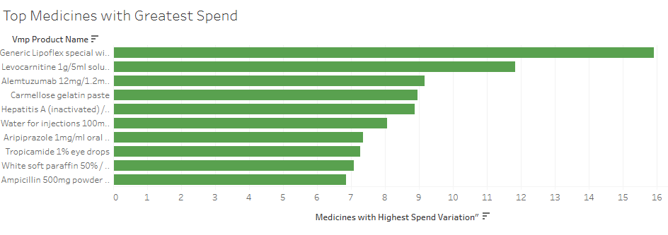
Top Medicines with Greatest Spend chart one

Slide 11
the medicines showing the greatest variation in usage and indicative spend across NHS Trusts are primarily high-cost or specialized treatments. Generic Lipoflex special tops the list, with an indicative spend approaching 16 units, suggesting significant variability in procurement or prescribing practices. Following this, Levocarnitine 1g/5ml solution shows a spend of around 12 units, reflecting its role in metabolic disorders where usage may vary between trusts. Alemtuzumab 12mg/1.2ml also demonstrates notable variation, with spend just above 9 units, highlighting differences in treatment for multiple sclerosis. Other medicines with substantial variation include Carmellose gelatin paste (~9 units), Hepatitis A (inactivated) vaccine (~9 units), and Water for injections 100ml (~8 units). This pattern indicates that both high-cost specialty drugs and certain essential formulations have inconsistent spend across trusts, likely driven by patient need, prescribing practices, and local formulary decisions.
Which high-cost medicines show the greatest variation in usage and indicative spend across NHS Trusts?(chart one)

Slide 12
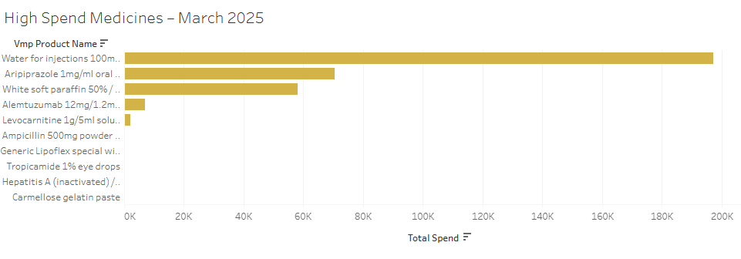
High Spend Medicines – March 2025 chart2

Slide 13
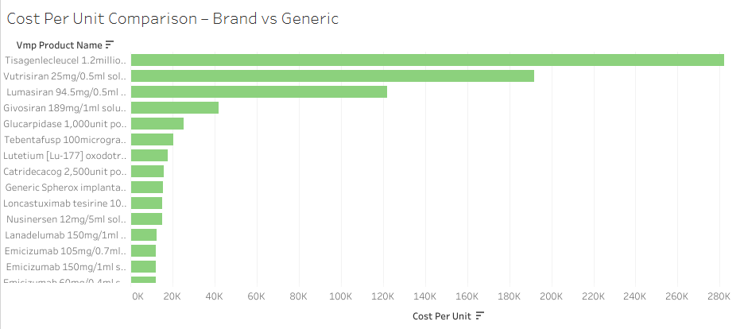
Cost Per Unit Comparison – Brand vs Generic chart3

Slide 14
Where are there opportunities for cost reduction through generic or biosimilar substitution without affecting patient care?
Based on chart two and three, several opportunities exist for cost reduction through generic or biosimilar substitution without compromising patient care. From the High Spend Medicines – March 2025 chart, “Water for injections 100ml” leads with a total spend approaching 200K, followed by Aripiprazole 1mg/ml oral solution (~70K) and White soft paraffin 50% (~58K). These products are often off-patent or have generic equivalents available, suggesting immediate potential for substitution. The Cost Per Unit Comparison – Brand vs Generic chart highlights extremely high-cost therapies such as Tisagenlecleucel 1.2 million units (~280K/unit) and Vutrisiran 25mg/0.5ml (~175K/unit). While these are complex biologics with limited substitution options, several mid-range expensive agents (e.g., Glucarpidase 1,000 unit (~25K/unit), Catridecacog 2,500 unit (~15K/unit)) may have biosimilar alternatives. Targeting high-volume, moderate-cost generics can achieve significant savings without impacting efficacy, especially for widely used medicines like Aripiprazole and White soft paraffin. Optimizing procurement through generics and biosimilars can reduce costs in the 50K–200K total spend range, potentially saving tens of thousands per month.

Slide 15
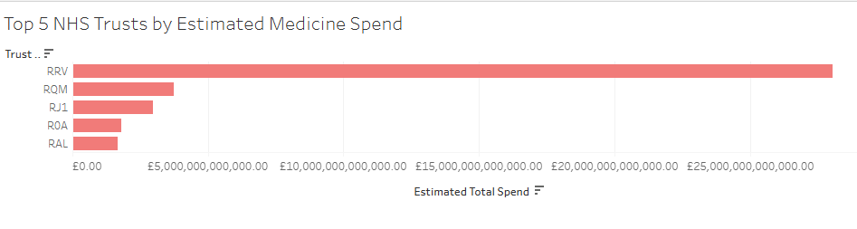
Top 5 Trusts by Estimated Total Spend chart four

Slide 16
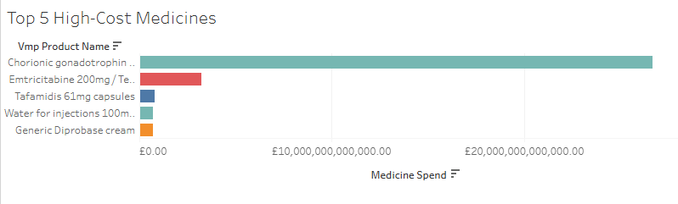
Top 5 High-Cost Medicines chart five

Slide 17
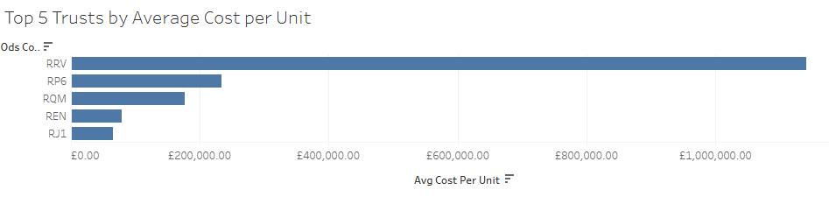
Top 5 Trusts by Average Cost per Unit chart six

Slide 18
Which NHS Trusts could improve efficiency in procurement or prescribing practices to optimise overall medicine spend? (chart four, five and six)
Based on the charts, the trust coded RRV presents the largest opportunity to improve procurement and prescribing efficiency. It shows the highest estimated total medicine spend at approximately £27 billion, significantly higher than the trust coded RQM (~£5 billion) and the trust coded RJ1 (~£4 billion). In addition, the trust coded RRV has the highest average cost per unit at around £1.1 million, which is more than four times higher than the trust coded RP6 (~£250,000) and well above the trust coded RQM (~£180,000).This combination of very high overall spend and high unit cost suggests potential inefficiencies in supplier contracts, purchasing frameworks, or prescribing patterns of high-cost medicines. The trusts coded RQM and RJ1 should also be reviewed due to their relatively high total expenditure. Meanwhile, the trust coded RP6, despite lower total spend, shows elevated unit costs, indicating possible product mix or pricing inefficiencies that warrant further procurement analysis.

Slide 19
Insight and recommendations for shareholders
Insights: The data show a highly concentrated spending pattern. One trust (code RRV) accounts for approximately £27 billion in estimated medicine spend and has the highest average cost per unit (~£1.1 million), indicating a significant cost outlier. Other trusts (codes RQM and RJ1) follow at ~£5 billion and ~£4 billion respectively. Additionally, certain medicines dominate overall expenditure, suggesting reliance on high-cost treatments. The variation in average unit costs across trusts highlights inconsistent procurement or prescribing practices. Recommendations for Shareholders: Prioritise a cost-efficiency review at the highest-spend trust, standardise procurement frameworks, benchmark prescribing practices across trusts, renegotiate supplier contracts, and implement stronger cost-control monitoring to reduce unwarranted variation and improve financial sustainability. Based on the High Spend Medicines – March 2025 chart, expenditure is highly concentrated. Water for injections 100ml accounts for nearly £200K, significantly higher than Aripiprazole 1mg/ml oral solution (~£70K) and White soft paraffin 50% (~£58K). The top three products alone contribute over £320K, indicating procurement concentration risk.The Cost per Unit – Brand vs Generic chart shows extreme unit price variation. Tisagenlecleucel costs approximately £280K per unit, while Vutrisiran is around £180K, and Lumasiran exceeds £120K per unit.Insight: Spending is driven by a small number of high-volume consumables and ultra-high-cost biologics.Recommendation: Negotiate bulk pricing for high-volume items (e.g., water for injections) and increase biosimilar uptake or regional procurement collaboration for therapies above £100K per unit to reduce financial exposure.

Slide 20
Limitation and next time
This analysis is limited by the use of a single month of data (March 2025), which restricts the ability to identify trends over time. Without multiple months or yearly data, it is not possible to assess whether medicine usage or spend patterns are increasing, decreasing, or influenced by seasonal pressures. As a result, conclusions about efficiency, variation, or potential overuse are based solely on one snapshot in time and may not be fully representative of typical prescribing behaviour. Additionally, while benchmarking Trusts highlights variation and potential cost-saving opportunities, the analysis cannot determine whether observed differences are sustained over time or driven by short-term operational factors. Some medicines naturally fluctuate due to treatment cycles, commissioning changes, or clinical demand, meaning March figures alone may distort actual patterns. To strengthen the robustness of findings, incorporating at least 2–3 months, or ideally a full year of data, would enable trend validation, reduce month-specific bias, and provide more reliable strategic recommendations for long-term cost optimisation.

Slide 21
Conclusion
This project analysed variation in high-cost secondary care medicines usage and indicative spend across NHS Trusts using the March 2025 SCMD dataset. The findings highlight significant differences in spending patterns between Trusts for certain medicines, with some products demonstrating substantial variation in total spend and cost per unit. These discrepancies suggest potential inefficiencies in procurement practices, prescribing behaviours, or supplier pricing agreements. By identifying the highest-spend medicines and those with the greatest variation, the analysis provides a targeted foundation for cost optimisation without compromising clinical quality. Additionally, opportunities for generic or biosimilar substitution were explored, indicating areas where standardisation and improved benchmarking could reduce unnecessary expenditure. Final note to stakeholders: Strategic optimisation of high-cost medicines presents a clear opportunity to enhance financial sustainability while maintaining patient care standards. Through improved data transparency, cross-Trust benchmarking, and evidence-based procurement strategies, NHS organisations can unlock measurable savings and reinvest resources into frontline services, innovation, and long-term healthcare resilience.

Slide 22
Reference and links used
Big query SQL – for cleaning and sorting
Tableau used for data visual - https://public.tableau.com/views/OptimisingHigh-CostMedicineUtilisationAcrossNHSTrusts/Top5TrustsbyAverageCostperUnit?:language=en-GB&:sid=&:redirect=auth&:display_count=n&:origin=viz_share_link
Dataset used - (Finalised) - Secondary Care Medicines Data (SCMD) with indicative price - Mar 2025 - https://opendata.nhsbsa.net/dataset/finalised-secondary-care-medicines-data-scmd-with-indicative-price
I do not own the dataset.

